Slide 1



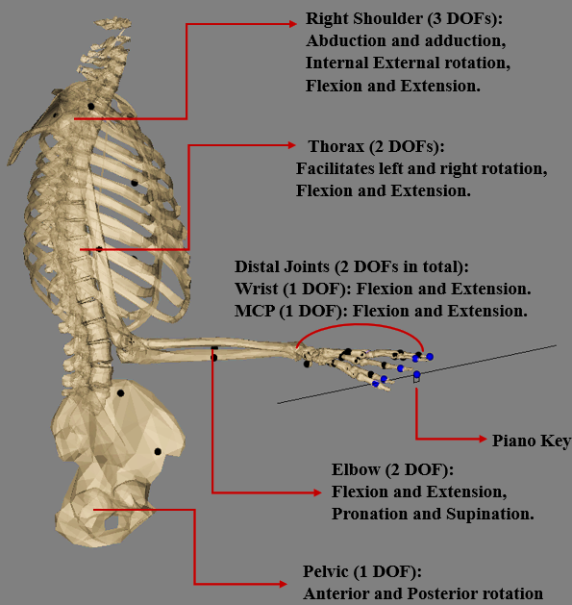

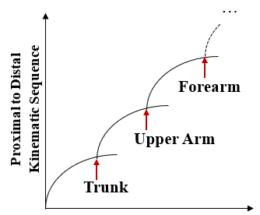
Optimizing Piano Technique: Use of Proximal Movement Strategies for Minimizing Distal Joint Torques
Mohammadali Shahiri, Pierre Puchaud, Eve Charbonneau, Mickael Begon, Felipe Verdugo
Literature:
Methodology:
Results:
Prevalence of Playing-Related Musculoskeletal Disorders among Pianists ranging from 40% to 90%
Visualizing the Architecture of the Upper Body Biomechanical Model
Analysis of Tau² Reduction Across Different Phases
 | % Difference Pressed Touch | % Difference Struck Touch
Phase_1 | 2 | 30.78
Phase_2 | 24.71 | 23.25
Phase_3 | 25.32 | 33.01
Phase_4 | 7.93 | 10.42
Phase_5 | — | —
The vulnerability of distal joints, particularly the metacarpophalangeal (MCP) and wrist joints
% Difference = (With – Without)/(With)
Conclusion
Objective:
Trunk involvement may reduce torque on distal joints by altering the workload distribution among upper body joints and could therefore contribute to movement strategies aiming to reduce exposure to risk factors of injuries.
Adopting an optimal control theory to better understand the potential benefits of using trunk movements in piano performance specifically aims to reduce torque at distal joints.

